Slide 1
RAG-based Query Suggestion Chatbot with Chain-of-Thought for WordPress Sites
﻿
Name: Bhawesh Kumar Singh

Slide 2
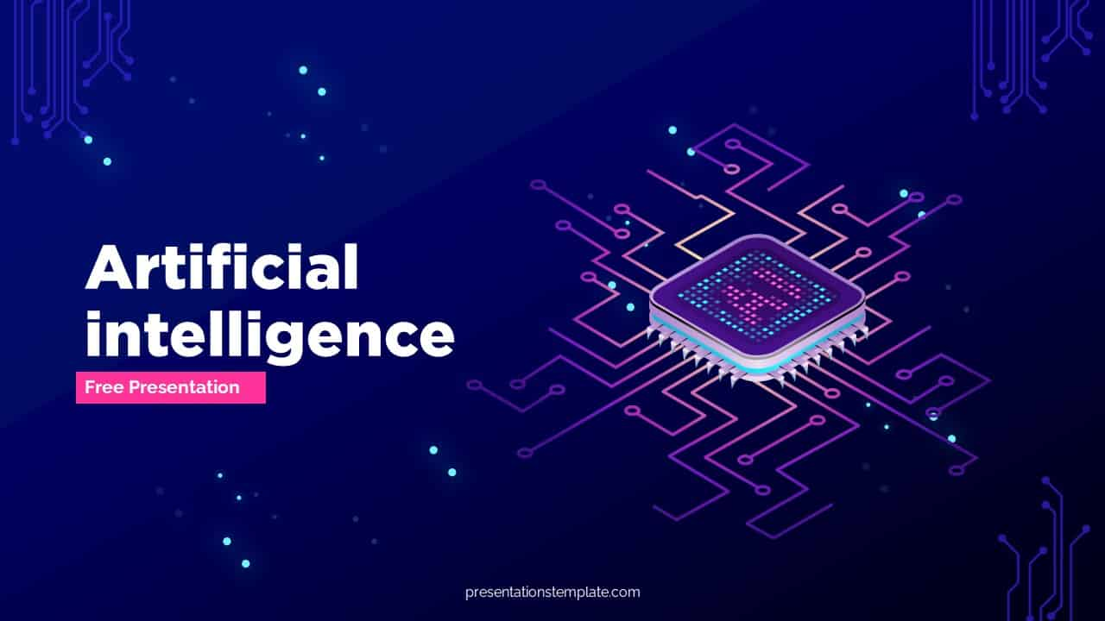
Slide 1: Introducing RAG: A Powerful NLP Approach ﻿ Unveiling RAG: A Novel Approach to Natural Language Processing. ﻿ Combines strengths of retrieval & generation models. ﻿ Leverages pre-trained language models for: Information retrieval. ﻿ Enables informative & contextually relevant responses

Slide 3
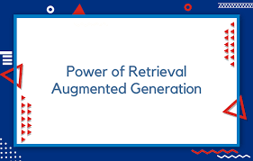
Slide 2: Unveiling the Building Blocks of RAG RAG: A Model Composed of Powerful Components Tokenizer: Transforms text into processable units (tokens) Example: "The cat sat on the mat" becomes ["The", "cat", "sat", "on", "the", "mat"] Retriever: Finds relevant information based on the query Think of it as a super librarian searching a vast knowledge base Generator: Crafts the response using retrieved info and the query Like a writer using research to create a compelling text Summary: The RAG model is like a well-oiled machine with three crucial components. The tokenizer acts as the prep chef, breaking down the input text into manageable pieces. The retriever then takes center stage, searching for relevant information from a vast knowledge source like a skilled librarian. Finally, the generator steps in as the writer, using the retrieved information and the query to craft a comprehensive response.

Slide 4
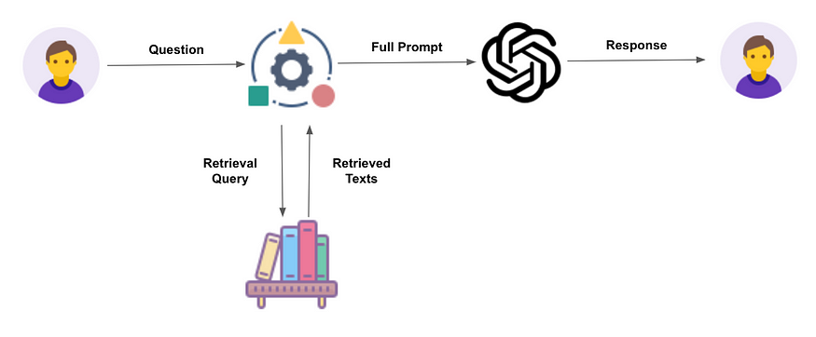
3. Process Overview: Slide 3: Step-by-Step: How RAG Generates Responses Unleashing RAG's Power: The Response Generation Process Tokenization: Break down the user's question into building blocks Context Retrieval: Find relevant information from the knowledge base Like searching a library with a super librarian! Response Generation: Craft an answer using the query & retrieved info Imagine a writer using research to create a response ﻿ Summary: The RAG model follows a clear-cut process to generate informative responses. First, the tokenizer tackles the user's query, chopping it up into smaller units called tokens. These tokens are then fed to the retriever, which acts like a super librarian, scouring a vast knowledge base for relevant context. Finally, the generator steps in, using both the processed query and the retrieved information to craft a comprehensive and contextually relevant response.

Slide 5
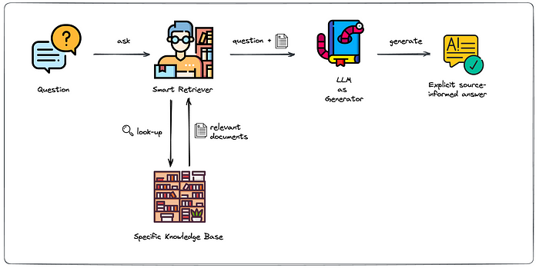
4. Integration with CoT (Chain of Thought) Logic: Slide 4: Beyond the Basics: RAG with Chain of Thought (CoT) Unveiling RAG's Secret Weapon: Chain of Thought (CoT) Logic CoT: Refines the initial response for enhanced accuracy Analyzes initial response & context for further reasoning May involve multiple logical steps for a more informative answer ﻿ Summary: The RAG model we've explored so far is already powerful. But the provided code unlocks an even more advanced capability: Chain of Thought (CoT) logic. Think of CoT as a built-in editor for the RAG model. It analyzes the initial response generated by RAG and the previous context to identify areas for improvement. CoT can then refine the response through a series of logical steps, potentially involving multiple passes to arrive at a more accurate and informative final response

Slide 6
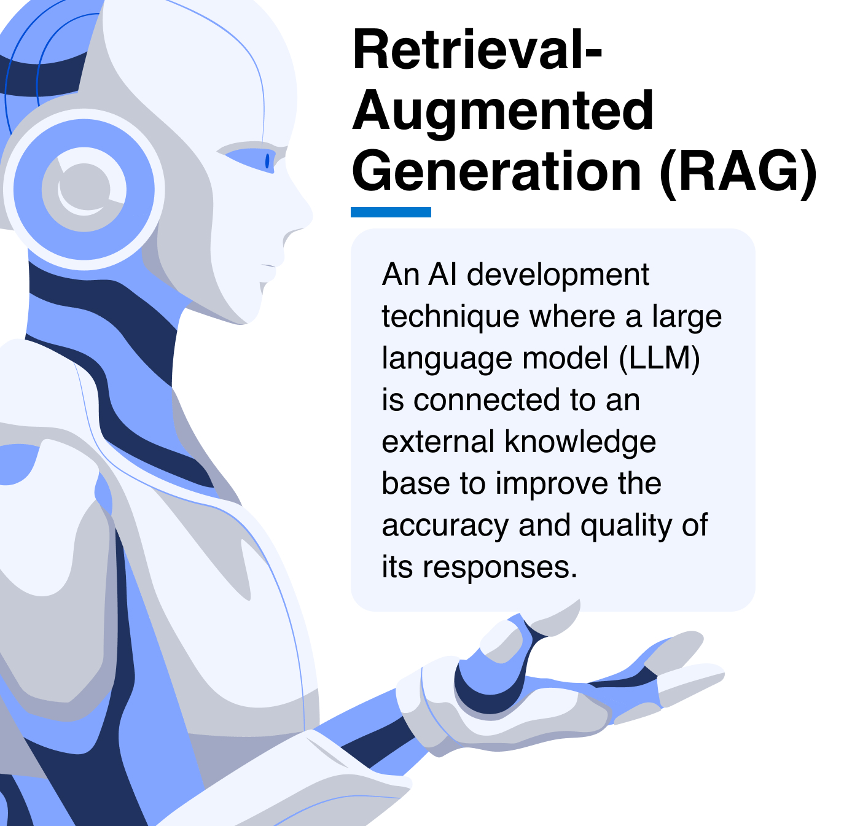
5. Conclusion: Slide 5: The Power of RAG: Conclusion RAG: A Game-Changer in Natural Language Processing Merges retrieval & generation for powerful NLP Retrieves relevant context for informative responses Ideal for applications like: Question answering Dialogue systems CoT integration boosts capabilities through logical reasoning ﻿ Summary: The RAG model represents a significant leap forward in natural language processing. By combining the strengths of retrieval and generation techniques, RAG can access and leverage relevant information to craft informative and contextually appropriate responses. This makes it a perfect fit for various NLP applications, including question answering systems and dialogue systems. Furthermore, the integration of Chain of Thought (CoT) logic empowers RAG with the ability to reason logically and refine its responses, leading to even more accurate and insightful results.

Slide 7
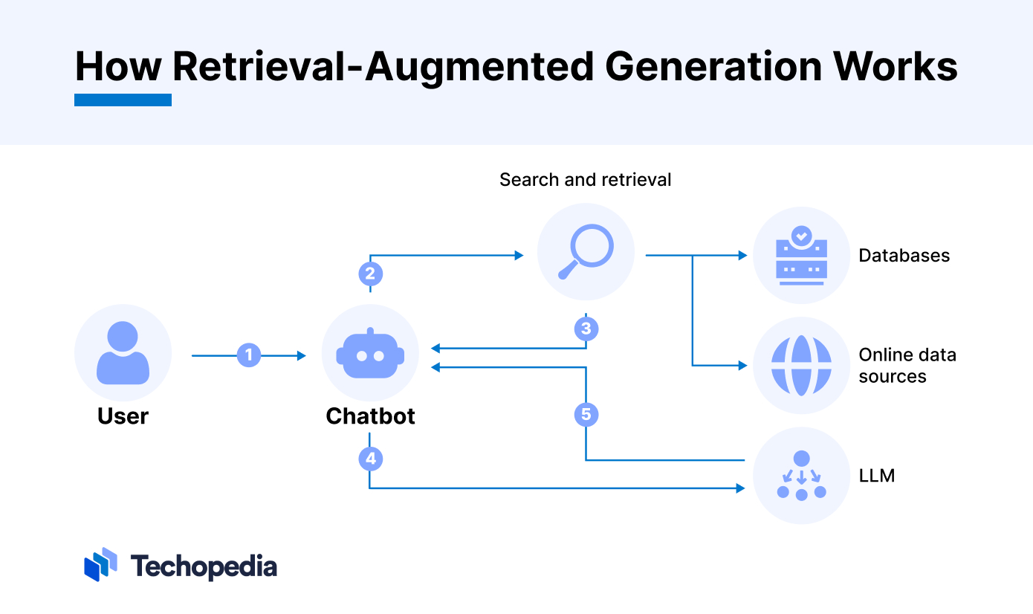
6. Future Directions: Slide 6: The Future of RAG: A World of Possibilities RAG: Paving the Way for NLP Advancements Optimizing retrieval & generation for even better performance Exploring diverse knowledge sources for broader understanding Enhancing CoT for advanced reasoning capabilities Real-world applications: Education: Personalized learning experiences Healthcare: Improved patient communication and support Customer Service: Efficient and informative interactions ﻿ Summary: The RAG model is not just a powerful tool; it's a springboard for future advancements in NLP. Researchers are actively exploring ways to optimize the retrieval and generation components, pushing the boundaries of RAG's capabilities. Additionally, integrating different knowledge sources will broaden its understanding of the world. Perhaps the most exciting frontier lies in enhancing the CoT logic with advanced reasoning frameworks, enabling RAG to tackle even more complex tasks. Beyond the research lab, RAG holds immense potential to revolutionize real-world applications. Imagine personalized learning experiences in education, improved patient communication in healthcare, and efficient, informative customer service interactions. The future of NLP with RAG is bright, filled with possibilities for innovation and positive impact.

Slide 8


